Slide 1

Micro Credit Defaulter
Submitted by:
Deepesh Singh

Slide 2
PROBLEM STATEMENT
A Microfinance Institution (MFI) is an organization that offers financial services to low income populations. MFS becomes very useful when targeting especially the unbanked poor families living in remote areas with not much sources of income. The Microfinance services (MFS) provided by MFI are Group Loans, Agricultural Loans, Individual Business Loans and so on.
Many microfinance institutions (MFI), experts and donors are supporting the idea of using mobile financial services (MFS) which they feel are more convenient and efficient, and cost saving, than the traditional high-touch model used since long for the purpose of delivering microfinance services. Though, the MFI industry is primarily focusing on low income families and are very useful in such areas, the implementation of MFS has been uneven with both significant challenges and successes.
Today, microfinance is widely accepted as a poverty-reduction tool, representing $70 billion in outstanding loans and a global outreach of 200 million clients.
We are working with one such client that is in Telecom Industry. They are a fixed wireless telecommunications network provider. They have launched various products and have developed its business and organization based on the budget operator model, offering better products at Lower Prices to all value conscious customers through a strategy of disruptive innovation that focuses on the subscriber.
They understand the importance of communication and how it affects a person’s life, thus, focusing on providing their services and products to low income families and poor customers that can help them in the need of hour.
They are collaborating with an MFI to provide micro-credit on mobile balances to be paid back in 5 days. The Consumer is believed to be defaulter if he deviates from the path of paying back the loaned amount within the time duration of 5 days. For the loan amount of 5 (in Indonesian Rupiah), payback amount should be 6 (in Indonesian Rupiah), while, for the loan amount of 10 (in Indonesian Rupiah), the payback amount should be 12 (in Indonesian Rupiah).

Slide 3
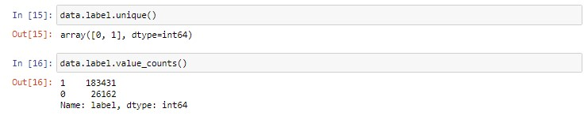
EDA Steps
In this we check the shape of the data, info, columns, d-types, null values and etc.
Drop the unusual columns of the data.
Check the unique value present in the label column.
Describe the data and find the mean of the data, standard deviation of the data.

Slide 4
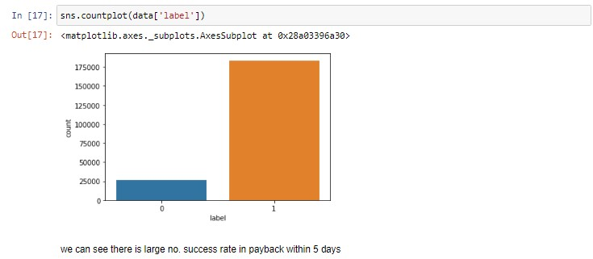
Visualization
Here we plot the count-plot.
In this count plot we can easily see the large no. of success rate of payback within 5 days.

Slide 5
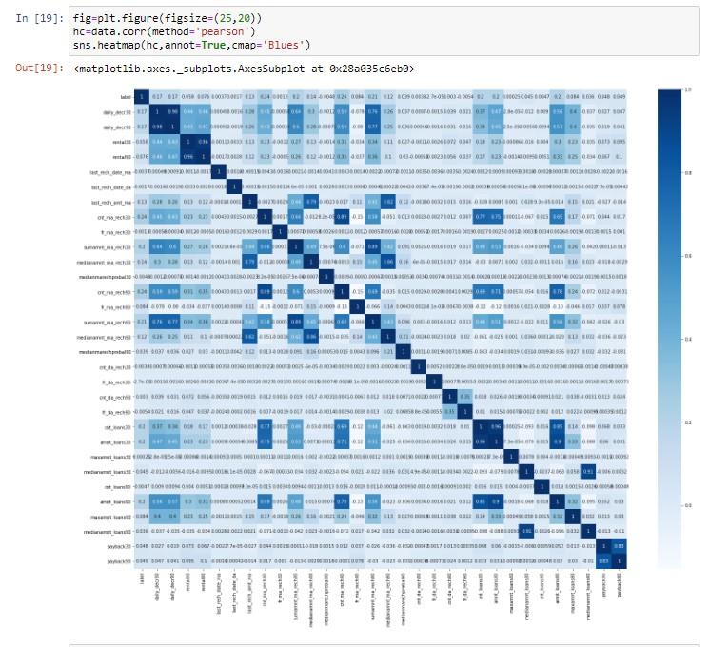
Visualization
Showing the correlation matrix by using the heatmap.

Slide 6
Steps and assumptions
In first step, load the dataset in csv format.
Then done a EDA on the dataset.
After that done a preprocessing in this we have remove the skewness present in the data by power transform method.
Then check for outliers by plotting boxplot of the each column, then see the outliers and remove it by using z-score.
Then done a standard scaling on the data and load it to the dataframe.
After that finding the best random state with Logistic Regression algorithm of 66.
Then create a train test split by using the test size of .30 and random state of 66.

Slide 7
Model Dashboard
In this step we build the model by using five algorithm .
Logistic Regression
Decision Tree Classifier
GaussianNB
Random Forest Classifier
Adaboost Classifier
And in all algorithm finding the accuracy score, confusion matrix, classification report of the data.

Slide 8
Finalized Model
With the best accuracy score of 91% Random forest is the best model ,also check the cross validation score and finalize the best model.
Then applied the hyper parameter tuning to enhance the accuracy score of the finalized model.
Applied the Grid Search CV with the parameters

Slide 9
Conclusion
In this report, I find the highest accuracy score of 91% with the random Forest classification after the EDA and data cleaning and the model building of the data.
The study showed that number of dependents, type of loan, adequacy of loan, duration for repayment of loan, period within the year the loan was acquired and how the customers rank the interest charged on the loan we
In this project we only find the defaulter and non-defaulter of the micro credit finance with the help of model building by different algorithms re significant determinants of micro credit default.

